Slide 1
Dependable Distributed Systems
Master of Science in Engineering in Computer Science
AA 2026/2027
Lecture 18: Registers in presence of byzantine processes

Slide 2
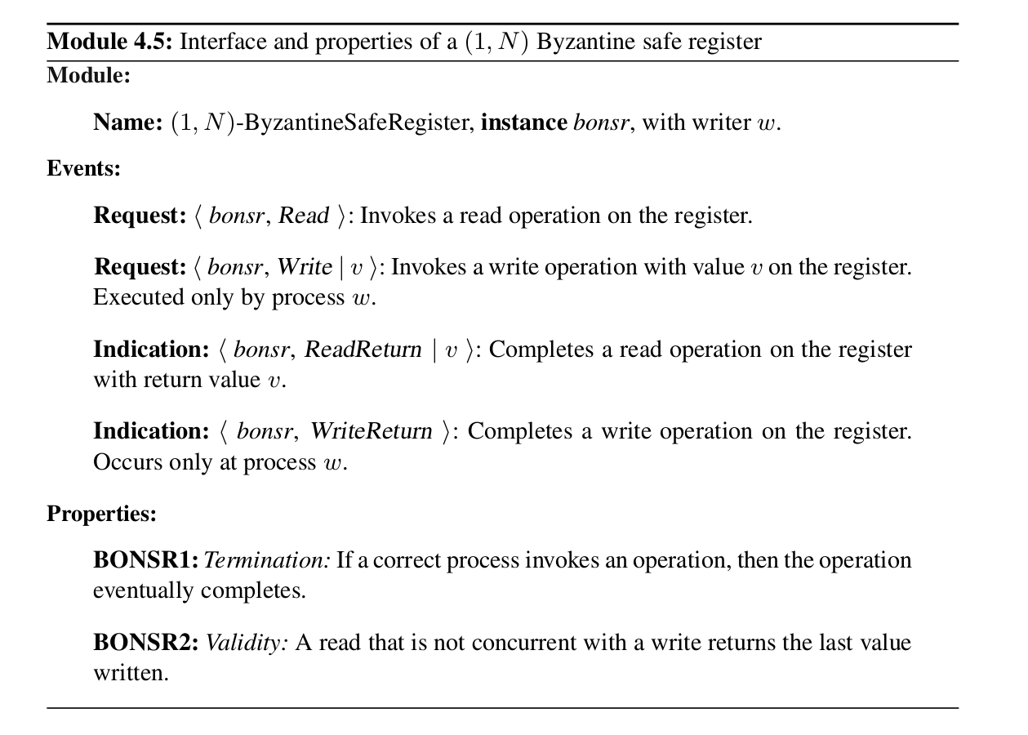
Safe Register Specification

Slide 3
Safe Register
Writer
Write (1)
Write (2)
Read()->1
Reader
Read()->5
Reader

Slide 4
Byzantine Tolerant Safe Register (1,n)
1 Writer
n Readers
Client-Server paradigm
Asynchronous System
autheticated perfect point-to-point link
f servers may be Byzantine
any client may crash but they cannot be Byzantine
Clients
W
write_return()
read_return(v’)
write(v)
read()
Do not confuse
n with N
Servers/Replicas

Slide 5
Safe Register Intuition
We have to assure that once writer returns from a write operation, then any following read operation returns the last written value.
  Write operation: sends <v,wts> to servers and waits for ACK messages.
How many ACK messages?
    Enough to be sure that enough correct servers deliver <v,wts>
  Read operation: sends a read request and waits for reply messages.
How many reply messages?
  Enough to be able to read newest value, not an old value or never written

Slide 6
How large should the quorum be?
Writer
write() returns
f
Correct servers with the last written value
Writer
Writer
1
2
Writer
f
Byzantine
servers
Very slow msg
f
f
f
f
f
f
f
f
f
f
f
1
f
1
1
1
If we consider: N>3f
Quorum: (N+f)/2
Reader could return an old value or nothing.
3
Reader
4
Reader
f
f
f
f
f
f
f
f
f
f
1
f
1
f
1
1

Slide 7
Masking Quorum
The kind of quorum working for Byzantine Broadcast here is not enough.
Safe Register has a stronger semantic with respect to broadcast. We require that a write operation is visible to all once it terminates.
To implement safe registers we use Masking Quorums:
N>4f
Quorum: (N+2f)/2 (i.e., 3f+1)

Slide 8
N>4f
Quorum: (N+2f)/2
Read return
Reader
Write return
Read()->v
Writer
Write(v)
Writer
1
f
f
Very slow msg
f
f

Slide 9
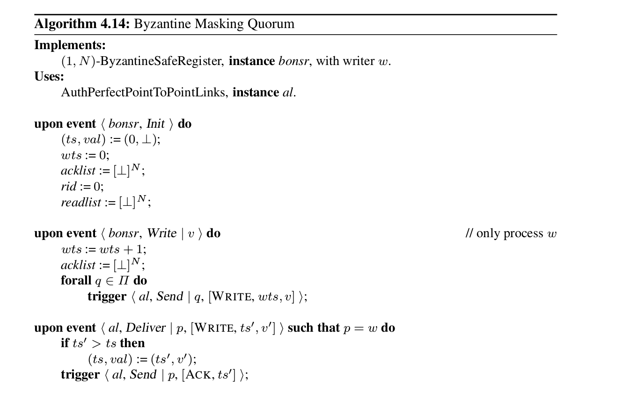
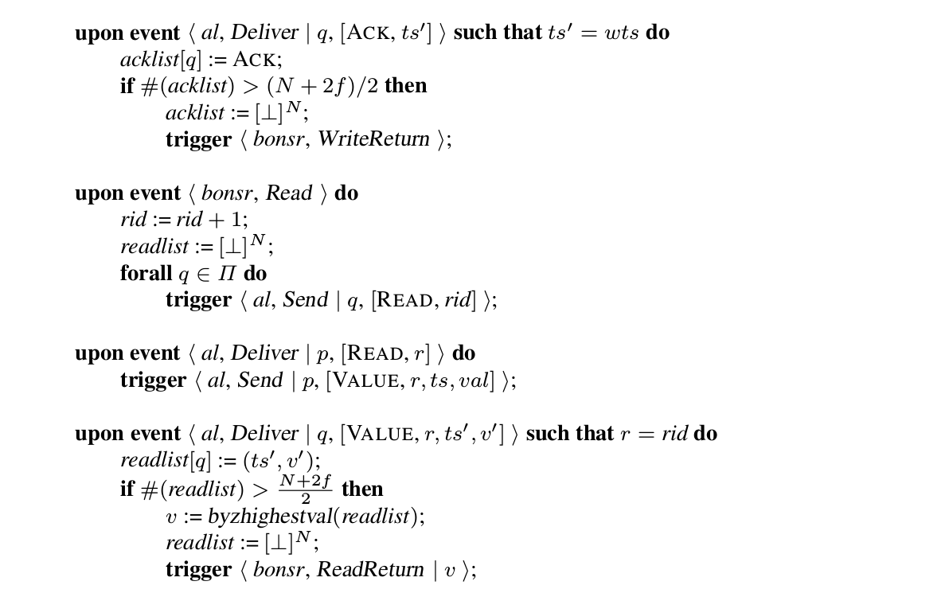
Assumption
N>4f
1
byzhighestval (·): selects the value from the pair that occurs more than f time and with the highest timestamp.
If no pair exists, the reader selects a default value v0 from the domain of the register.
2

Slide 10
N>4f
Quorum: (N+2f)/2
Read return
Reader
Write return
Read()->v
Writer
Write(v)
2
Writer
1
1
f
f
Very slow msg
f
f

Slide 11
Regular Registers
The specification does not change
We will discuss two implementations:
Using cryptography
Without cryptography

Slide 12

Regular Register
Implementation with cryptographic assumptions
BASIC IDEA -> evolution of Majority voting Algorithm
  the writer signs the timestamp/value pair
  Processes store it together with the signature
  The reader verifies the signature on each timestamp/value pair received in a VALUE message and ignores those with invalid signatures
    A Byzantine process is prevented from returning an arbitrary timestamp and value in the VALUE message, although it may include a signed value with an outdated timestamp

Slide 13
Regular Register
Implementation with cryptographic assumptions
Assumption
N>3f
i.e. > 2f
i.e. > 2f

Slide 14
N>3f
Quorum: (N+2f)/2
Very slow msg
Read return
Reader
Write return
Read()->v
Writer
Write(v)
2
Writer
1
1
f
f
#1 <v, 1, 𝞼(v, 1)>
#f < 0, 0, 𝞼(0, 0)> correct but slow
#f < 0, 0, 𝞼(0, 0)> Byzantine
f

Slide 15
N>3f
Quorum: (N+2f)/2
Very slow msg
Read return
Read()->v
Reader
Writer
Write(v)
Writer
1
f
f
#1 <0, 0, 𝞼(0, 0)>
#f < 0, 0, 𝞼(0, 0)> correct but slow
#f < 0, 0, 𝞼(0, 0)> Byzantine
f

Slide 16
Regular Register
Implementation without cryptographic assumptions
Assumption
N>3f
the writer process p uses two phases to write a new
  a pre-write phase and
  a write phase
Why one phase is not enough?
In order to terminate, the write cannot wait more than N-f ack (i.e., 3)
The reader is not able to choose a value:
Value ⊥could be old given that process s provided value x with ts 1
Value x could be a fake value generated by a Byzantine process

Slide 17
Regular Register
Implementation without cryptographic assumptions
the writer process p uses two phases to write a new
  a pre-write phase: the writer sends PREWRITE messages with the current timestamp/value pair. Then it waits until it receives PREACK messages from N − f processes
  a write phase: the writer sends ordinary WRITE messages, again containing the current time- stamp/value pair, and then waits until it receives ACK messages from N −f processes
Every process stores two timestamp/value pairs, one from the pre-write phase and one from the write phase

Slide 18
Intuition
r can infer that one of the three processes is faulty (the writer received N − f ack for the pre-write phase for (1, x) hence, either s sent the wrong written pair or q sent the wrong pre-written pair, as r itself is obviously correct).
(0, ⊥)
(0, ⊥)
write (x)
p
(1, x)
(0, ⊥)
(1, x)
(1, x)
q
(0, ⊥)
(0, ⊥)
(0, ⊥)
(0, ⊥)
r
(0, ⊥)
(0, ⊥)
(0, ⊥)
(0, ⊥)
(1, x)
(1, x)
s
(1, x)
(0, ⊥)
(1, x)
(1, x)

Slide 19
Regular Register write Implementation without cryptographic assumptions

Slide 20
Regular Register read Implementation without cryptographic assumptions
TRUE if readlist contains a pair (ts,v) that is found in the entries of more than f processes
readlist contains a pair (ts,v) such there is a Byzantine quorum (Q) of entries in readlist whose highest timestamp/value pair, selected among the pre-written or written pair of the entries, is (ts, v)

Slide 21
Example

Slide 22
Regular Register without cryptographic assumptions: Observations
Termination property must be relaxed in to finite-write termination
  Instead of requiring that every operation of a correct process eventually terminates, a read operation that is concurrent with infinitely many write operations may not terminate
  It has been shown that such a relaxation is necessary

Slide 23
Exercise
Does the Regular Register implementation without cryptographic assumption satisfy also the atomic specification?

Slide 24
References
C. Cachin, R. Guerraoui and L. Rodrigues. Introduction to Reliable and Secure Distributed Programming, Springer, 2011
  Chapter 4 – Sections 4.6 and 4.7

